Slide 1
Programming JAVA {
Hiveed.java
JAVA PROGRAMMING ;
/* Here is where your journey for your dream begins */
}
JAVA Programming

Slide 2
Programming JAVA {
Hiveed.java
Looping Statement ;
/* Here is where your journey for your dream begins */
}
JAVA Programming

Slide 3
Table Of ‘Contents’ {
01
02
03
Hiveed.java
For Loop ;
While Loop;
do While loop;
}
JAVA Programming

Slide 4
Hiveed.java
What is Looping Statement :
Loops in Programming Language come into use when programmer need to repeatedly execute a block of statements .
It's a fundamental construct used for automating repetitive tasks or processing elements of data structures.
JAVA Programming

Slide 5
Hiveed.java
For loop :
The for statement consumes the initialization, condition, and increment/decrement in one line thereby providing a shorter, easy-to-debug structure of looping.
For loop syntax :
for (initialization exp; test exp; update exp)
{
// body of the loop
// statements we want to execute
}
JAVA Programming

Slide 6
Hiveed.java
For loop parts :
Initialization Expression .
Test Expression.
Update Expression.
NOTE:
All these parts are optional in for loop.
1. Initialization Expression
In this expression, we have to initialize the loop counter to some value.
Ex : int i=0 ;
JAVA Programming

Slide 7
Hiveed.java
For loop parts :
2.Test Expression
In this expression, programmer have to test the condition. If the condition evaluates to true then, loop will execute the body of the loop and go to the update expression.
Otherwise, we will exit from the for a loop.
Ex :
i<=10
JAVA Programming

Slide 8
Hiveed.java
For loop parts :
3. Update Expression:
After executing the loop body, this expression increments/decrements the loop variable by some value.
Ex :
i++/i--
JAVA Programming

Slide 9
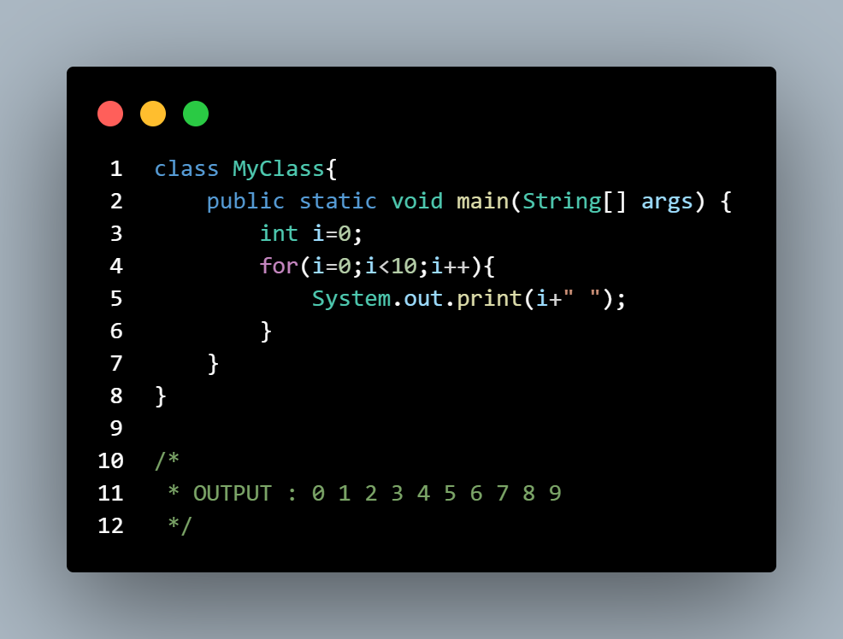
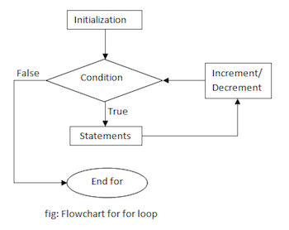
Hiveed.java
JAVA Programming

Slide 10
Hiveed.java
While Loop :
while loop is a control flow statement that allows code to be executed repeatedly based on a given Boolean condition .
The while loop is considered as a repeating “ if statement “. If the number of iterations is not fixed, it is recommended to use the while loop.
Note :
The differnece between while loop and if condition is performance.While loop perform better than the if condition.
JAVA Programming

Slide 11
Hiveed.java
While Loop syntax :
while (test_expression)
{
// statements
update_expression;
}
JAVA Programming

Slide 12
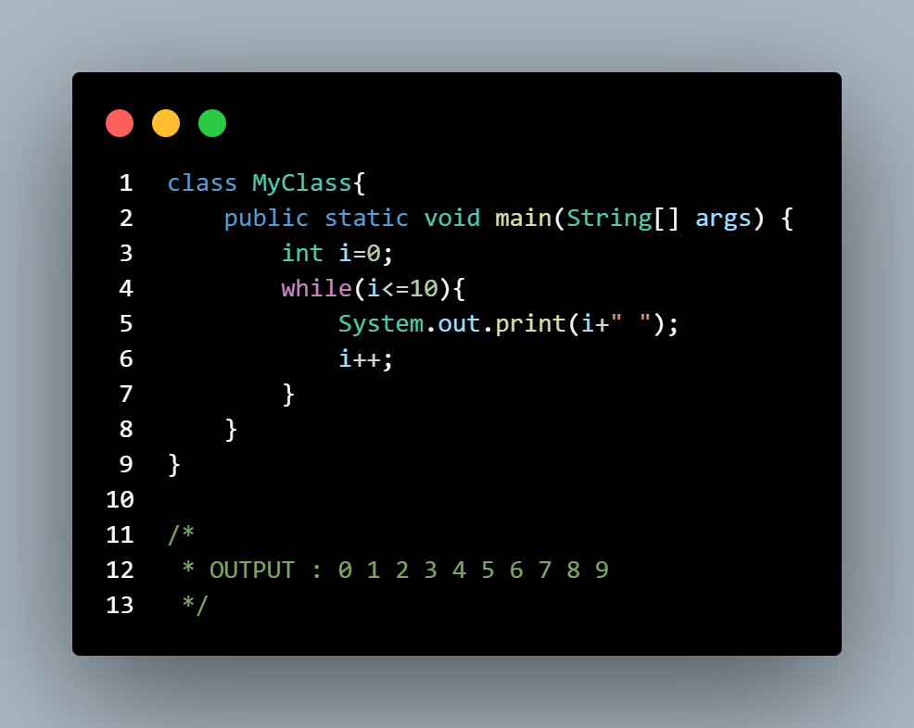
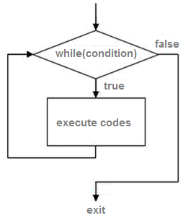
Hiveed.java
While Loop syntax :
JAVA Programming

Slide 13
Hiveed.java
do While Loop :
Java do-while loop is an Exit control loop.
Therefore, unlike for or while loop, a do-while check for the condition after executing the statements of the loop body.
or
The do while loop execute the statement then it check the condition..
Note :
The minimum iteration of while loop is 0 and do while loop 1
JAVA Programming

Slide 14
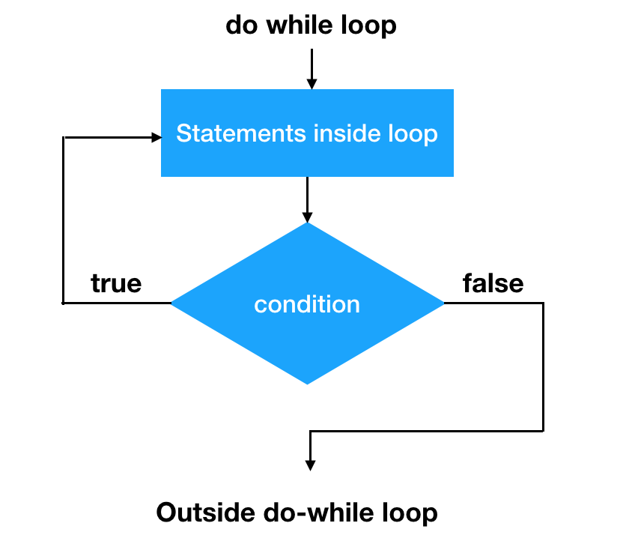
Hiveed.java
do While Loop syntax :
do
{
// Loop Body
Update_expression
}
// Condition check
while (test_expression);
Test expression is boolean type
JAVA Programming

Slide 15
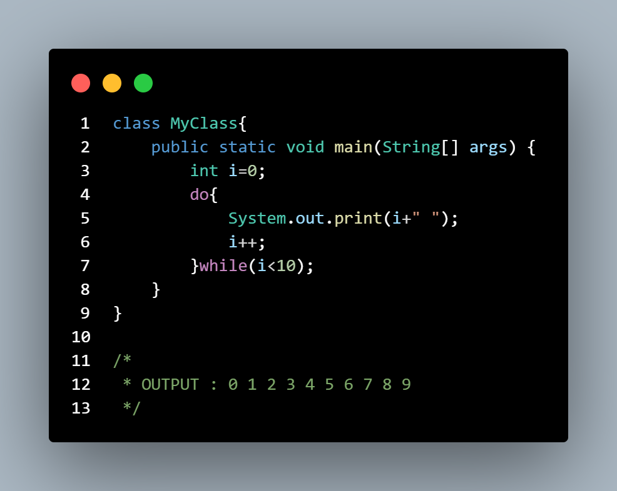
Hiveed.java
Example :
JAVA Programming

